Slide 1
CHAPTER 16: The User View of Operating Systems
The Architecture of Computer Hardware, Systems Software & Networking:
An Information Technology Approach
5th Edition, Irv Englander
John Wiley and Sons ©2013
PowerPoint slides authored by Angela Clark, University of South Alabama
PowerPoint slides for the 4th edition were authored by Wilson Wong, Bentley University

Slide 2
User Interface (UI)
Primary function
  Help the user use the computer system productively
  Make computer facilities accessible to the user to allow the user to get work done conveniently and efficiently
Secondary function
  Common look and feel for applications
  Provide consistent user interface tools to application programs to lower learning curves and increase productivity
Copyright 2013 John Wiley & Sons, Inc.
16-<number>

Slide 3
UI Access to Services
Three different approaches:
Command Interface
  Accepts commands directly from the user interface
  Either graphical (GUI) or command line (CLI)
Command language
  Accepts and executes groups of commands as a program
  Also known as scripting languages
Application Programming Interface (API)
  Accepts and performs requests directly from the user’s programs
Copyright 2013 John Wiley & Sons, Inc.
16-<number>

Slide 4
Typical OS User Services
Loading and execution of program files
File commands
User I/O services
Security and data integrity
Interuser communication and data sharing
System status and administration tools
I/O, file, and specialized services for user programs
Copyright 2013 John Wiley & Sons, Inc.
16-<number>

Slide 5
UI Utilities
Used in place of programs to manipulate the data within files and programs
Can be combined using a command language to create powerful programs
Examples
  Sorting data and files
  Retrieving data selectively from files
  Modifying data in files
Copyright 2013 John Wiley & Sons, Inc.
16-<number>

Slide 6
Program Execution
Operands
  Name of files passed to the program
  Parameters passed to the program that affect program behavior
Command Line Interface
  Type the name of the program and submit it to the operating system
Graphical User Interface
  Double-click or finger tap on a graphical icon
  Double-click on a data file icon. Program associated with the data file is executed with the data file as an operand.
Batch mode
  Run programs non-interactively
Copyright 2013 John Wiley & Sons, Inc.
16-<number>

Slide 7
File Commands
File command categories
  Storage
  Retrieval
  Organization
  Manipulation of files
Important features of a file management system
  Ability to treat files by a logical name without regard to physical characteristics or storage location
  Handle physical manipulation of files and translate between logical and physical representations
  Issue commands to the OS that store, manipulate, and retrieve files
  Ability to construct an effective file organization
Copyright 2013 John Wiley & Sons, Inc.
16-<number>

Slide 8
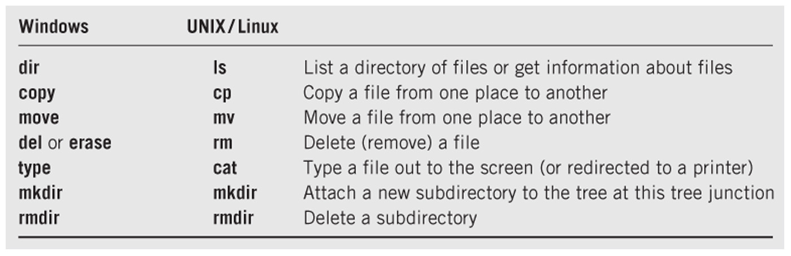
Common File Commands
Copyright 2013 John Wiley & Sons, Inc.
16-<number>

Slide 9
I/O Device Commands
Commands for direct operation on I/O devices
Formatting and checking disks
Copying entire disks
Sending output to a screen or printer
Queuing system for spooling output to a printer
Mounting or unmounting an I/O device
  Attaching or detaching a directory structure of a device to an existing directory structure
  Used in Unix/Linux
Copyright 2013 John Wiley & Sons, Inc.
16-<number>

Slide 10
Security and Data Integrity Protection
Protection from unauthorized read, write, or execution
Protection from deletion
Unix: three levels of security in form of read, write, and execute privilege for owner, group, and anyone else
Windows: access control lists (ACLs)
Copyright 2013 John Wiley & Sons, Inc.
16-<number>

Slide 11
Interuser communication and disk sharing operations
Program sharing
  Place shared program in a common memory space where all users can reach them
Data file sharing and data integrity issues
  Multiple users working on a single document
  Databases
OS message passing services
  E-mail, FTP, terminal facilities (telnet, ssh), http, instant messaging, audio and video conferencing
OS services to permit program to communicate with one another
  File redirection and pipe commands
Copyright 2013 John Wiley & Sons, Inc.
16-<number>

Slide 12
System Status Information and User Administration
Common system status commands
  Amount of available disk space
  Amount of available memory
  Number of users on the system and who they are
  % of time that CPU and I/O channels are busy
Logging facility that maintains a file of all keyboard and screen I/O
Copyright 2013 John Wiley & Sons, Inc.
16-<number>

Slide 13
System Status Information and User Administration
Tools for analyzing and controlling system
  Turn features on/off
  Set network connections
  Control programs
  Real-time graphs of dynamic performance such as CPU usage, I/O, memory
  Add/remove users, change permissions, limit disk usage, improve performance
Copyright 2013 John Wiley & Sons, Inc.
16-<number>

Slide 14
Program Services
Services the OS provides directly to programs
File services
I/O services
API (application programming interface)
  Library of service functions that may be called by a program
  Parameters are passed to the selected service function
  Service routine returns results to the calling program
Copyright 2013 John Wiley & Sons, Inc.
16-<number>

Slide 15
Interface Designs
Two major types of interface designs
  CLI – Command Line Interface
    Windows command prompt
    UNIX/Linux command prompt
    Batch system commands
  GUI – Graphical User Interface
    Supplanted the CLI for most day-to-day use
    Limited web browser interface for some combinations of Windows versions and browser versions
Copyright 2013 John Wiley & Sons, Inc.
16-<number>

Slide 16
Command Line Interface
command <operand1> <operand2> …
<switch1> <switch2> …
Operands
  keyword (switches) and/or positional
Windows example to save a directory listing in a file
  dir pathparta\pathpartb > putfilea
Equivalent Linux example
  ls –lF pathparta/pathpartb > putfilea
Copyright 2013 John Wiley & Sons, Inc.
16-<number>

Slide 17
Batch System Commands
Similar interface to command line interpreter
  command <operand1> <operand2> …
Specify location of programs to be executed and data to be used
Uses a Job Control Language (JCL)
Programs are executed with no human interaction
Example: IBM zOS/Job Control Language
How is this different from shell scripts?
Copyright 2013 John Wiley & Sons, Inc.
16-<number>

Slide 18
Graphical User Interfaces
Mouse or finger pointer-driven and icon-based
Examples: Apple Mac and Windows PCs; Iphone, Android, and Blackberry smartphones and tablets
WYSIWYG
Windowing Systems
  May vary in appearance but share similar graphical and operational elements
  Contain desktop or screens, icons, windows, title bar, task bar, clock, menu bar, and gadgets or widgets
Copyright 2013 John Wiley & Sons, Inc.
16-<number>

Slide 19
Interface Designs
Web browser as a user interface
  Not really part of the operating system
  Provides a consistent, simple interface well-suited to less experienced users
  Growing proliferation of applications with a web-based interface
Copyright 2013 John Wiley & Sons, Inc.
16-<number>

Slide 20
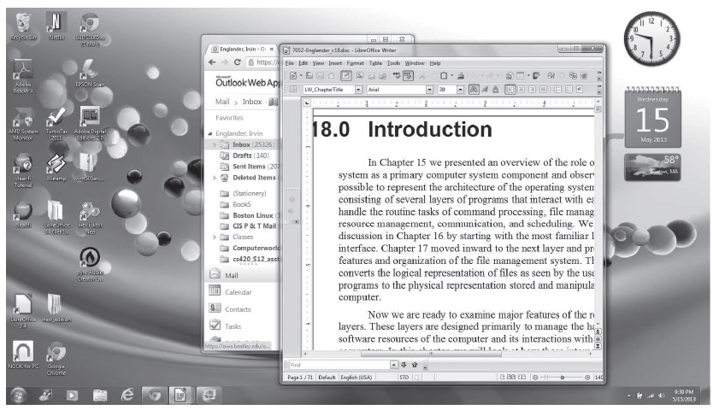
GUI Interface – Windows 7
Copyright 2013 John Wiley & Sons, Inc.
16-<number>

Slide 21
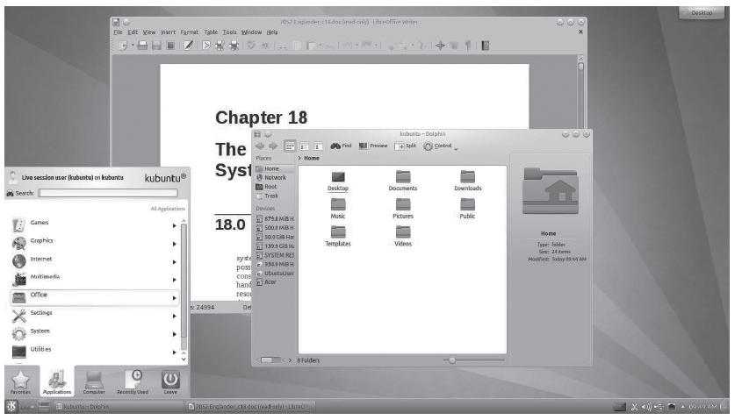
GUI Interface – Linux KDE
Copyright 2013 John Wiley & Sons, Inc.
16-<number>

Slide 22
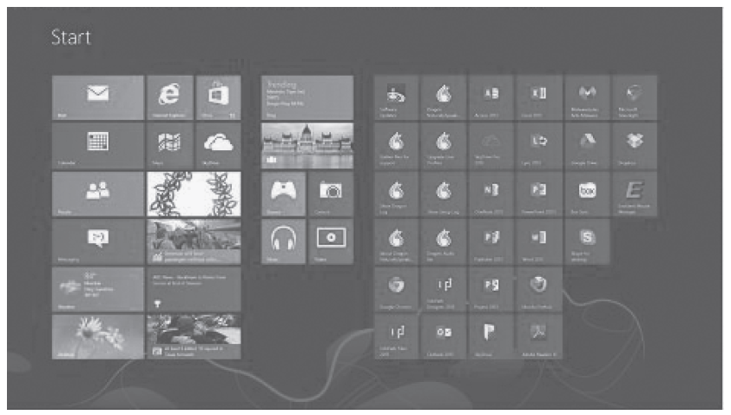
GUI Interface – Windows 8
Copyright 2013 John Wiley & Sons, Inc.
16-<number>

Slide 23
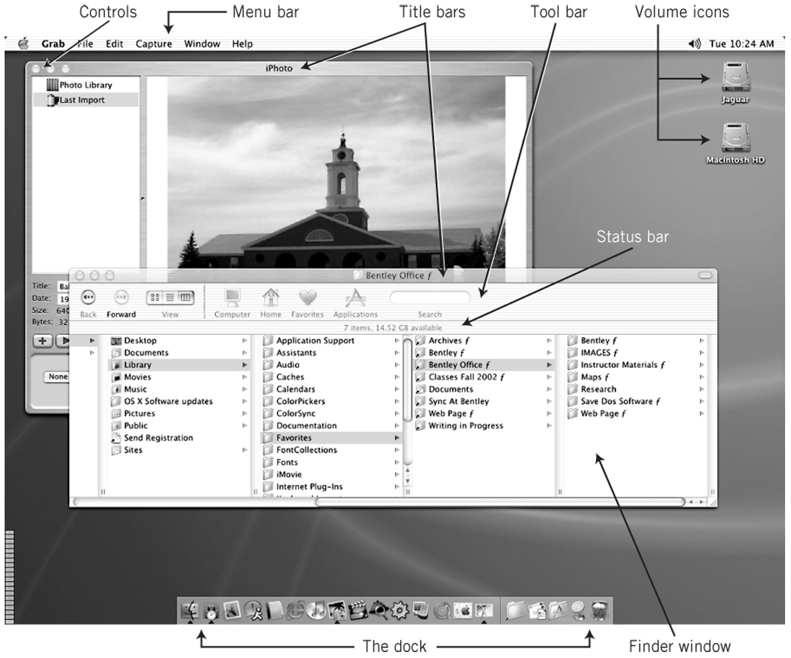
GUI Interface – MacIntosh OSX
Copyright 2013 John Wiley & Sons, Inc.
16-<number>

Slide 24
Touchless Gesture- and Voice-based Interfaces
Use of voice commands and gestures with no physical connection to the system is rapidly evolving
Originally designed for computer games but now applied to IT and general use
Examples:
  Body movement in Microsoft Kinect Xbox games
  Siri voice commands on Apple iPhones
  Eye-movement display on Samsung S4 smartphones
Copyright 2013 John Wiley & Sons, Inc.
16-<number>

Slide 25
GUI vs. CLI
GUI
Advantages
  Easy to learn and use
  Little training
  Amenable to multi-tasking
Disadvantages
  Harder to implement
  More HW/SW requirements
  Requires lots of memory
  SW is complex and difficult to write
CLI
Advantages
  More flexible and powerful
  Faster for experienced users
  Can combine commands
  Can use wild cards to apply a command to multiple files or directories
Disadvantages
  More difficult to learn and use
Copyright 2013 John Wiley & Sons, Inc.
16-<number>

Slide 26
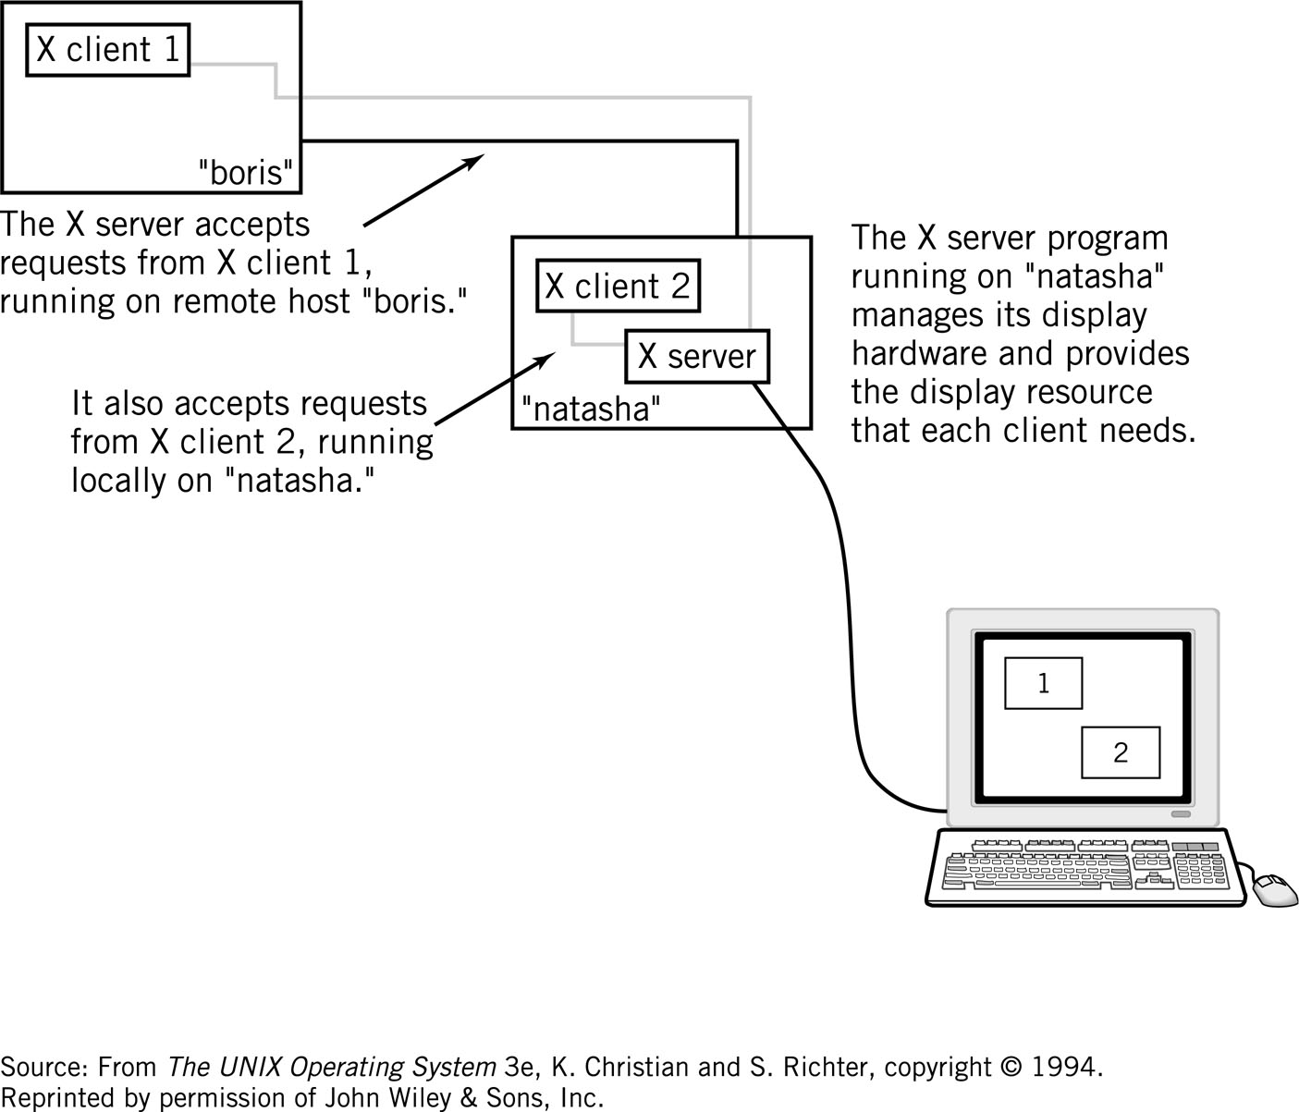
X-Windows
Copyright 2013 John Wiley & Sons, Inc.
16-<number>

Slide 27
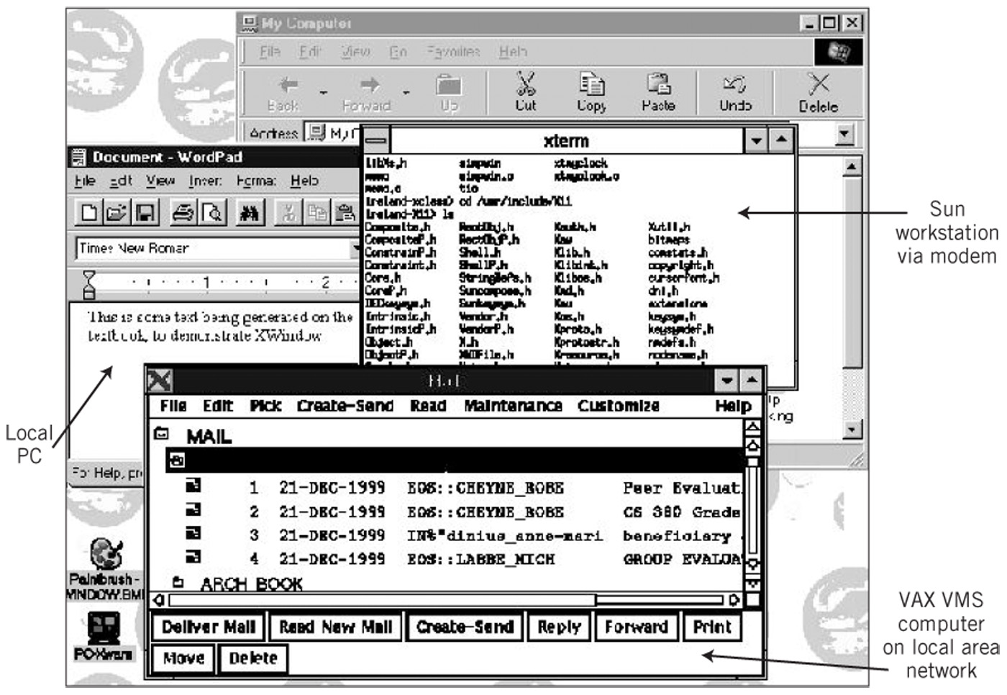
Multicomputer X-Window Display
Copyright 2013 John Wiley & Sons, Inc.
16-<number>

Slide 28
Command Languages
Provide a mechanism to combine sequences of commands together. These pseudo-programs are known as scripts or batch files.
Startup files – OS configuration, user preferences
Features of Command Languages
  Can accept input from the user and can output messages to I/O devices
  Provide ability to create and manipulate variables
  Include the ability to branch and loop
  Ability to specify arguments to the program command and to transfer those arguments to variables within the script
  Provide error detection and recovery
Copyright 2013 John Wiley & Sons, Inc.
16-<number>

Slide 29
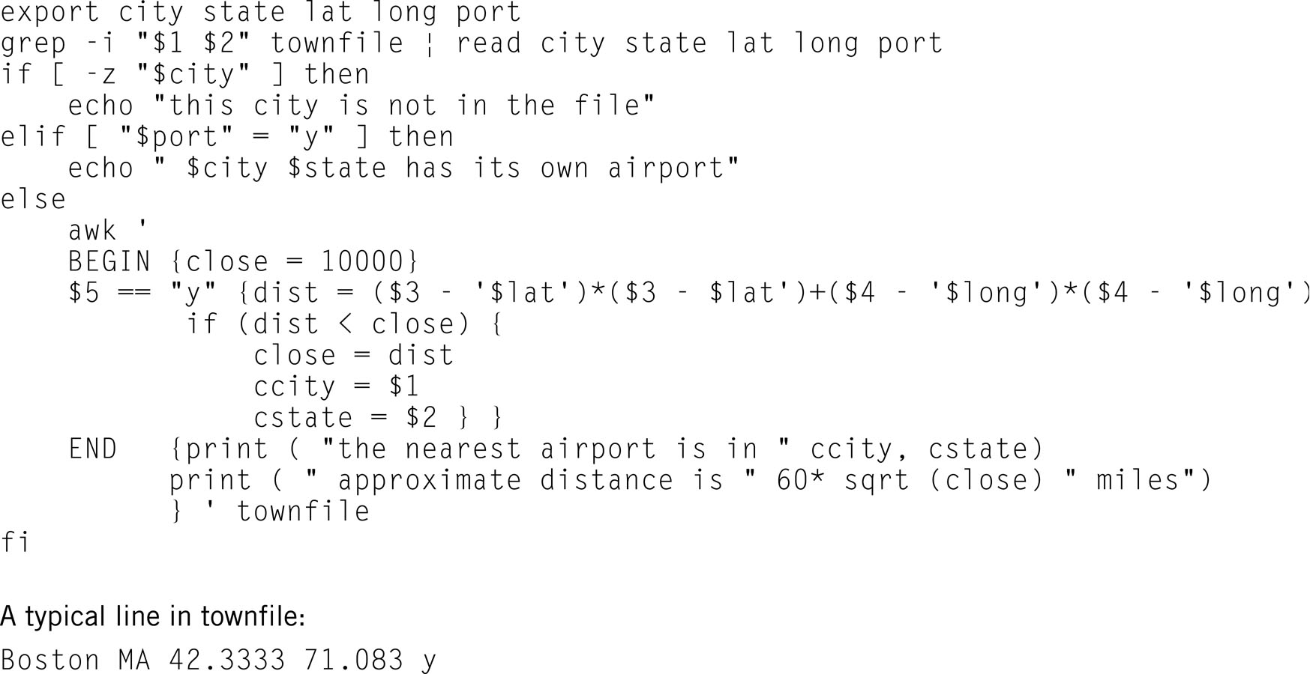
Example: Linux Shell Script
Copyright 2013 John Wiley & Sons, Inc.
16-<number>

Slide 30
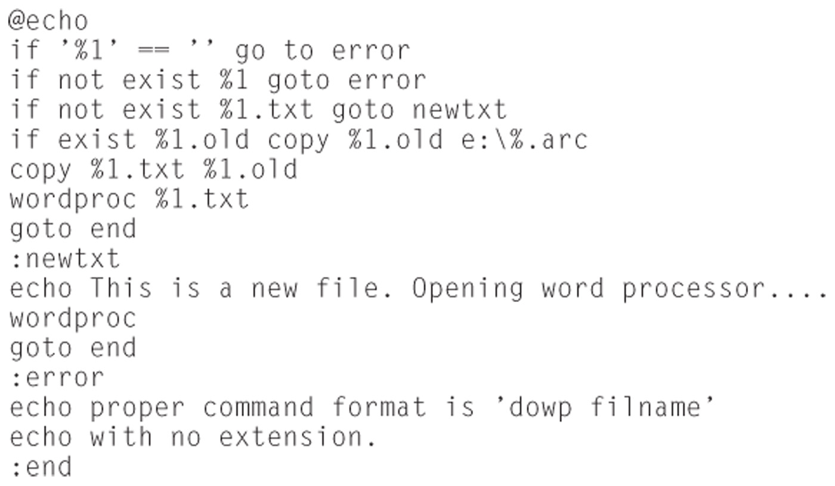
Windows Program DOWP
Copyright 2013 John Wiley & Sons, Inc.
16-<number>

Slide 31
Services to Programs
Allow programs to locate and share objects, often across a network
Ease a programmer’s task in creating new programs by providing commonly required program objects
  .NET
  CORBA
  Remote Procedure Call (RPC)
Copyright 2013 John Wiley & Sons, Inc.
16-<number>

Slide 32
Copyright 2013 John Wiley & Sons
All rights reserved. Reproduction or translation of this work beyond that permitted in section 117 of the 1976 United States Copyright Act without express permission of the copyright owner is unlawful. Request for further information should be addressed to the Permissions Department, John Wiley & Sons, Inc. The purchaser may make back-up copies for his/her own use only and not for distribution or resale. The Publisher assumes no responsibility for errors, omissions, or damages caused by the use of these programs or from the use of the information contained herein.
Copyright 2013 John Wiley & Sons, Inc.
16-<number>

